Slide 1
Notes regarding the slides
The slides are valid as at January 2021 and refer to Version 3.3 of the firmware.
The slides are based on the default settings of the device.
Slides discussing settings for which admin or super user rights are necessary or useful are identified as follows:
The slides must be selected depending on the target audience.
Special rights required

Slide 2
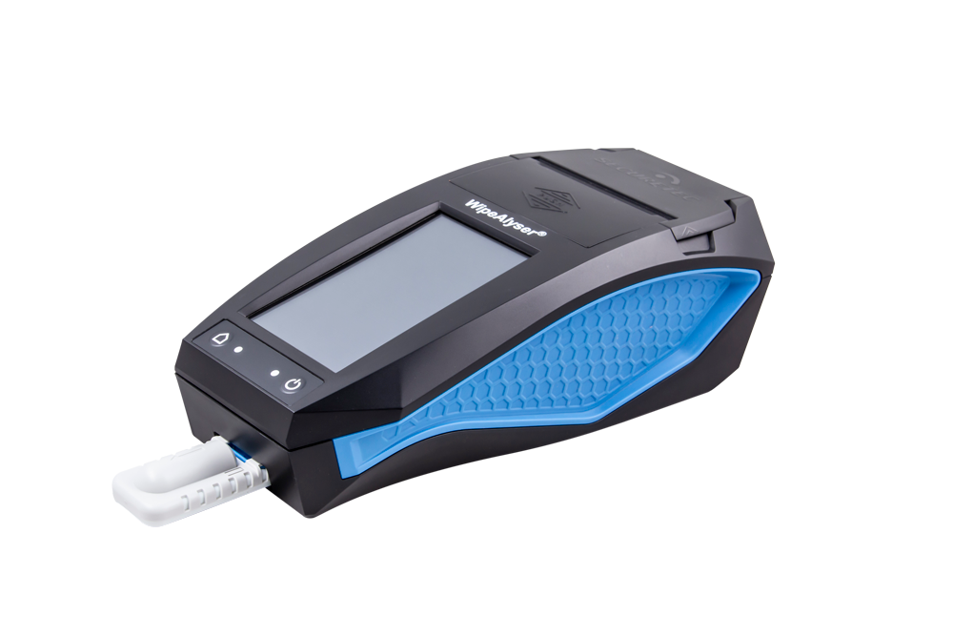
WipeAlyser Training
Part 1: General

Slide 3
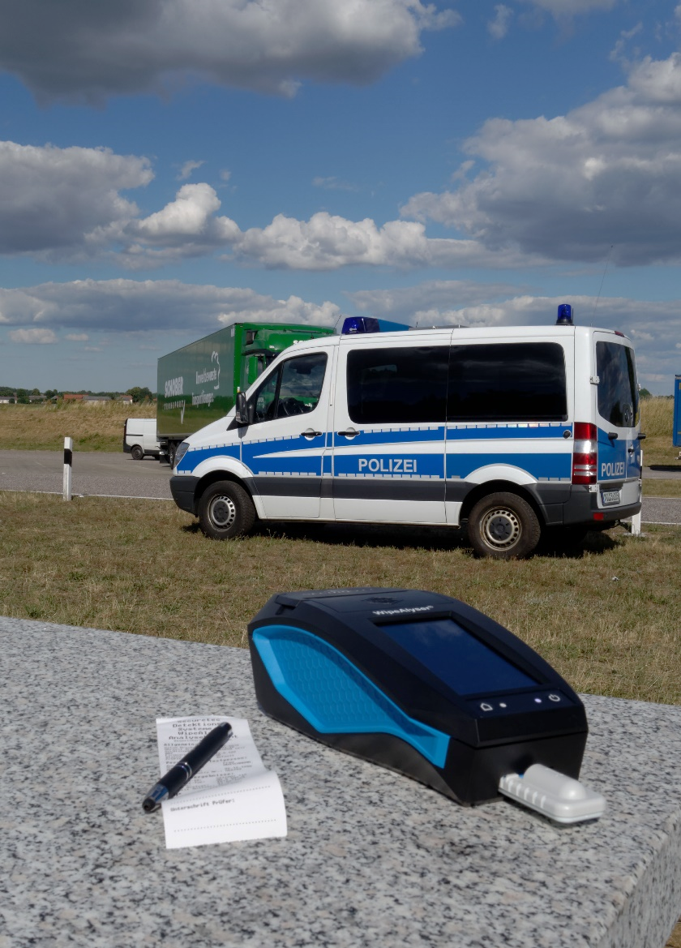
WipeAlyser Analyser System
WipeAlyser is an electronic analyser.
It is used to objectively
evaluate,
store and
document
rapid drug screening test results
by mobile users.

Slide 4
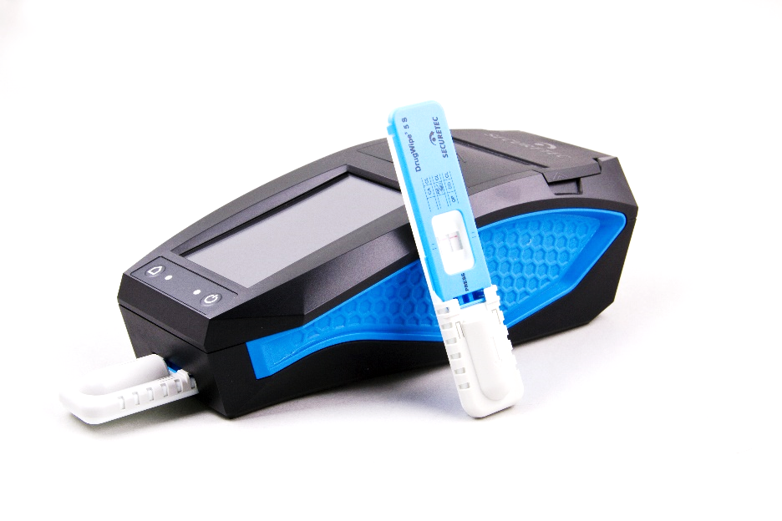
Using WipeAlyser with DrugWipe
WipeAlyser is compatible with DrugWipe S tests.
The device returns a qualitative result, i.e. positive/negative.
DrugWipe can still be evaluated visually.
The WipeAlyser result is authoritative.
Drug combinations and cutoffs depend on the DrugWipe type used.

Slide 5
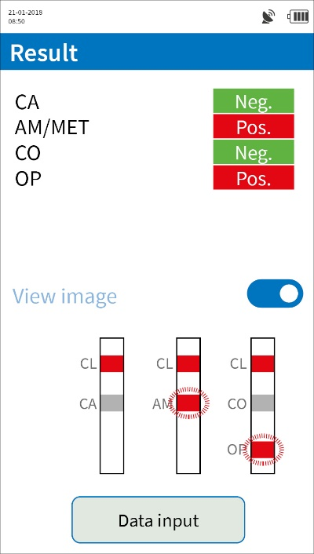
WipeAlyser – a drug pre-screening device
WipeAlyser is a screening test device.
Positive results must be validated by the laboratory.

Slide 6

Temperature
Operating temperature: +5 to +40°C
(same as DrugWipe)
Storage temperature: −30 to +80°C
(up to 24 hours)
The temperature is monitored by the device and checked prior to measurement.

Slide 7
Dust and moisture
WipeAlyser is protected against dust and splash water (IP 54).
WipeAlyser is resistant to splash water (printer lid closed); however, heavy rain
and long-term exposure can still damage the device.
Contamination of the optical system with dust can affect the measurement result.
Run the QC test at regular intervals.

Slide 8
Resistance to impact and vibrations
Up to a certain degree, WipeAlyser is resistant to impact and vibrations*.
But please remember that WipeAlyser is a high-end optical measuring device. It should be handled with care.
The carrying bag offers additional protection.
* in accordance with IEC 60068-2-64, IEC 60068-2-27
8

Slide 9
Device controls
Touchscreen
Home button to go to the main menu
Start button with On/Off function
Result status LED:
: negative
: positive
: Flashing = test invalid
Status LED:
: On
: Eco mode
: Flashing = charging
: Steady light = fully charged
: Flashing = hardware error

Slide 10
Device connections
Code scanner
for barcode scanning
Connector for power supply
USB port for connecting
a PC or car charger adapter
SD card slot
for exporting data
A Reset button is located at the bottom in case the device “freezes up.”

Slide 11
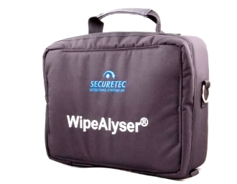
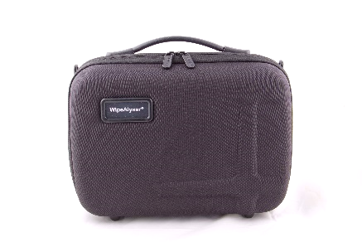
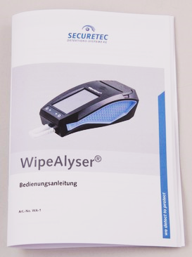
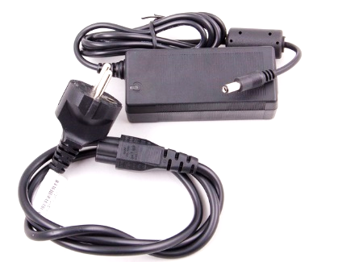
Accessories
Carrying bag
User Guide
Power cord and power supply

Slide 12
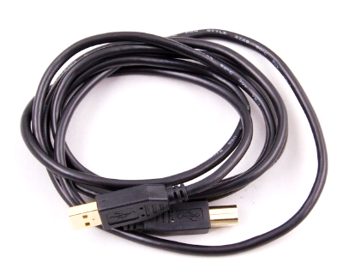
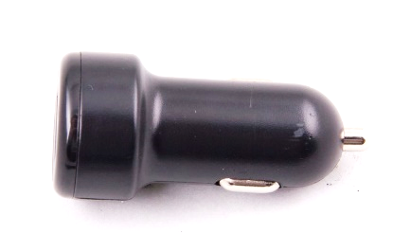
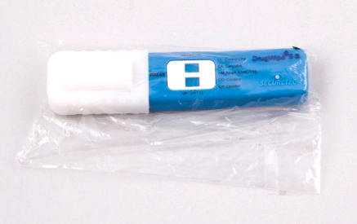
Accessories
USB cable for data transfer to the PC and powering the device via car charger adapter
Car charger adapter
USB stick with PC software and PDF user guides

Slide 13
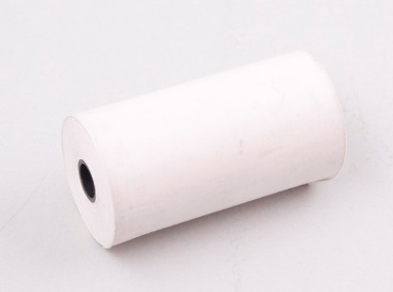
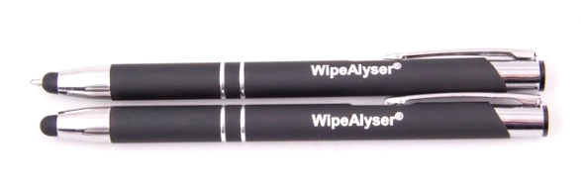
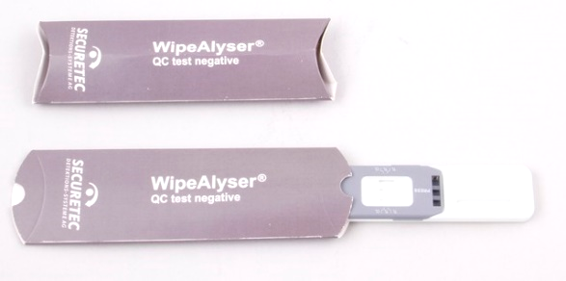
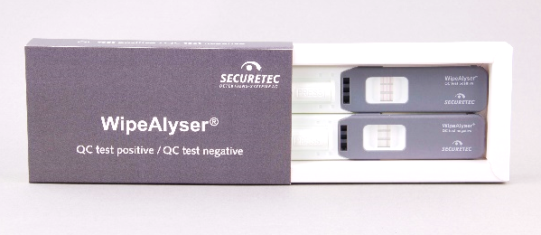
Accessories
Roll of printer paper
(thermal paper, 56 mm wide)
Styluses
Quality control tests (QC tests)

Slide 14
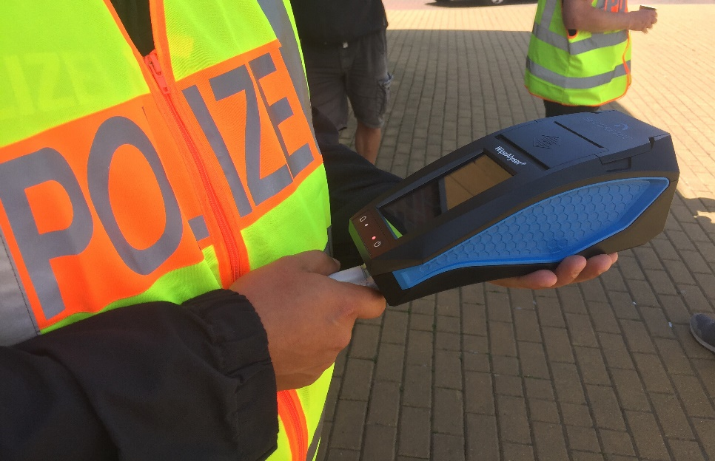
WipeAlyser Training
Part 2: How to perform a measurement

Slide 15

Start-Up
Press the Start button to power on WipeAlyser.
The welcome screen appears.

Slide 16
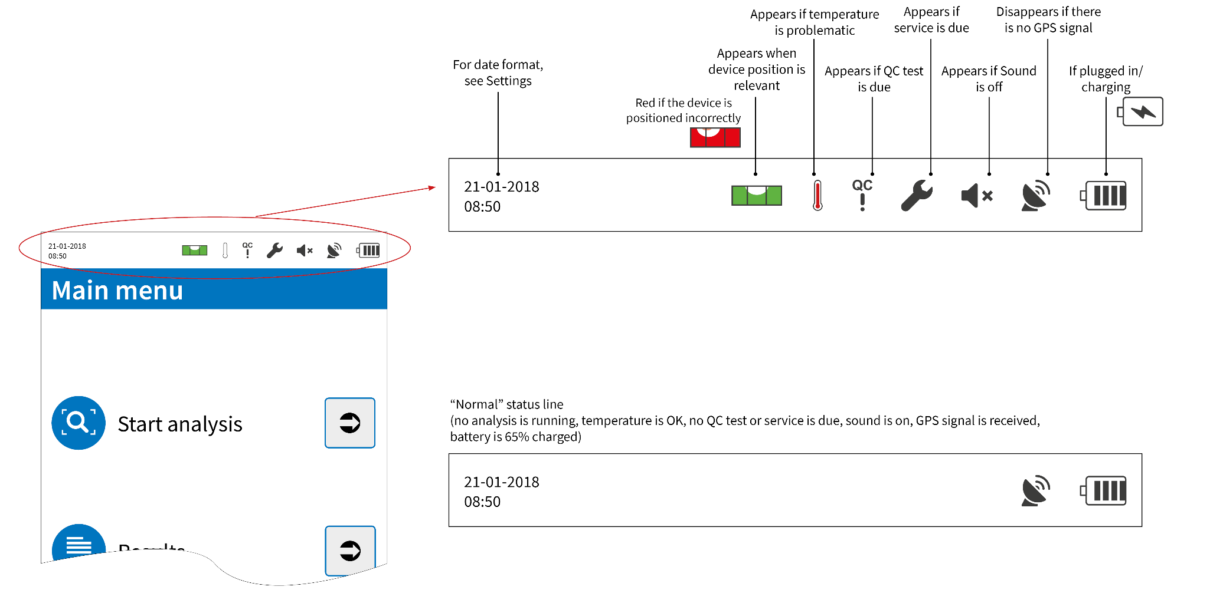
Status bar

Slide 17
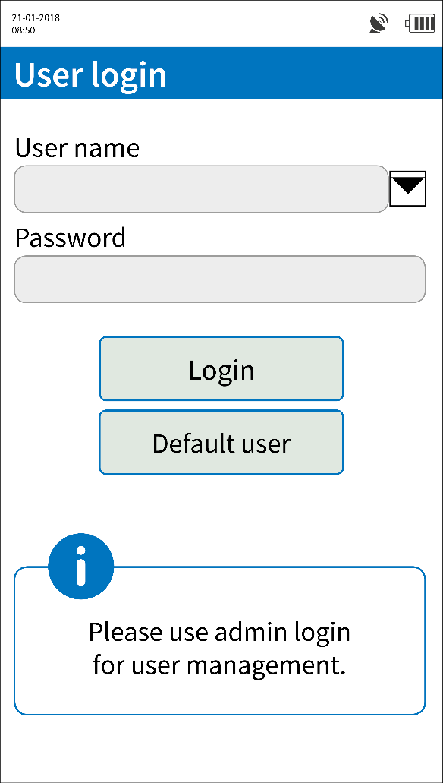
Login
Login requires a user name and password.
The administrator is responsible for user management.
You can also log in as standard user. This keeps the user anonymous and can be disallowed by the administrator.

Slide 18
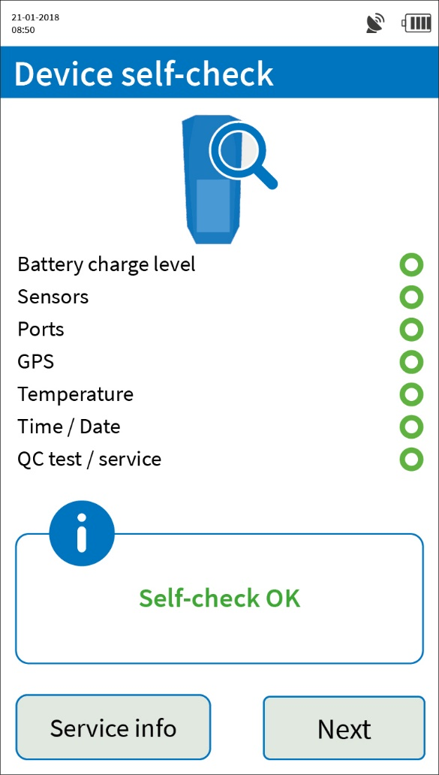
Self-check
After login, the device runs through
a self-check.
This checks the technical condition of WipeAlyser.

Slide 19
Self-check
Battery sufficiently charged
Sensors operational (e.g. level sensor)
Interfaces operational (e.g. USB)
GPS signal received (outdoors only)
Temperature within allowed measuring range
Time/date set and plausible
No QC tests or service due

Slide 20
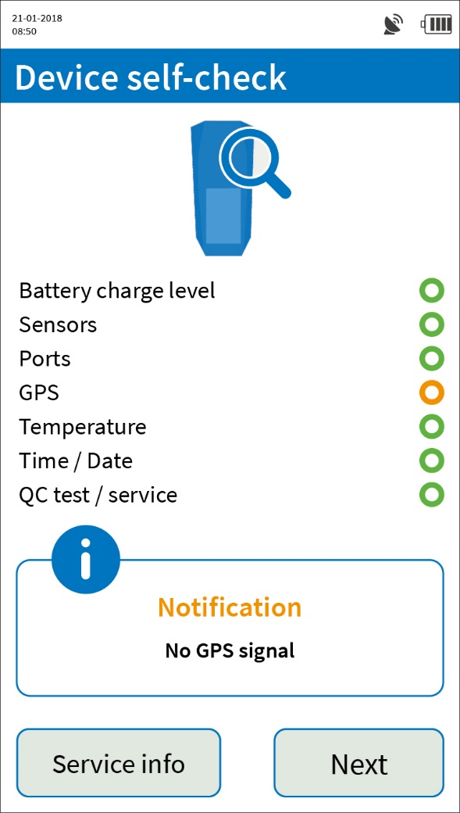
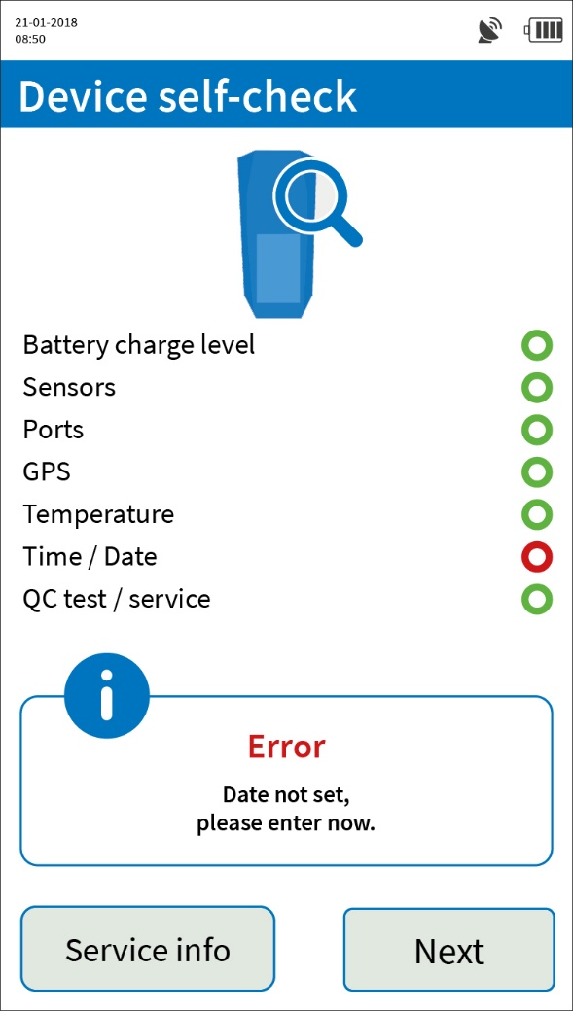
Self-check
Notification (yellow) means that measurements are still possible.
Error (red) means that action is required and the device is not ready for measurement.

Slide 21

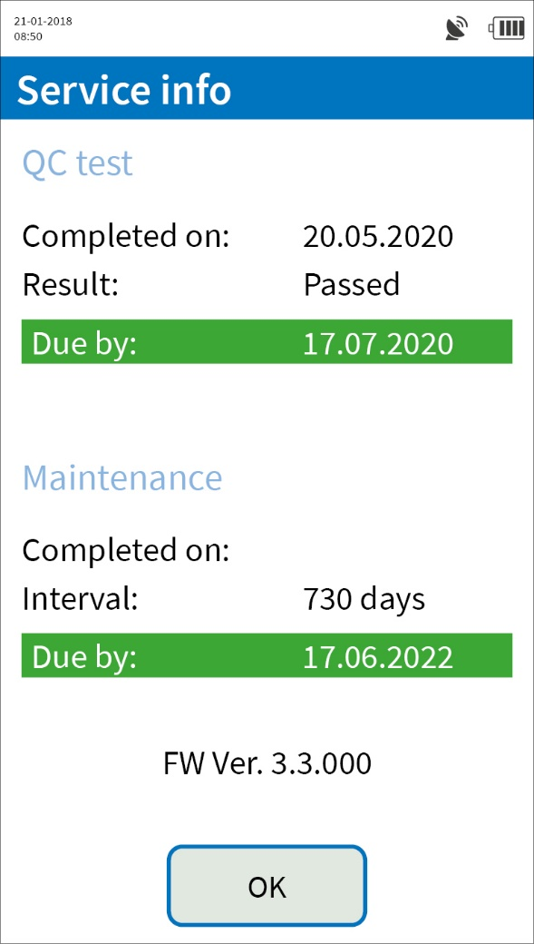
Service info
You can check the date of the most recent QC test and most recent maintenance under Service Info.
If a QC test or maintenance is due, the appropriate notification is highlighted in red.
The firmware version is specified below this.

Slide 22
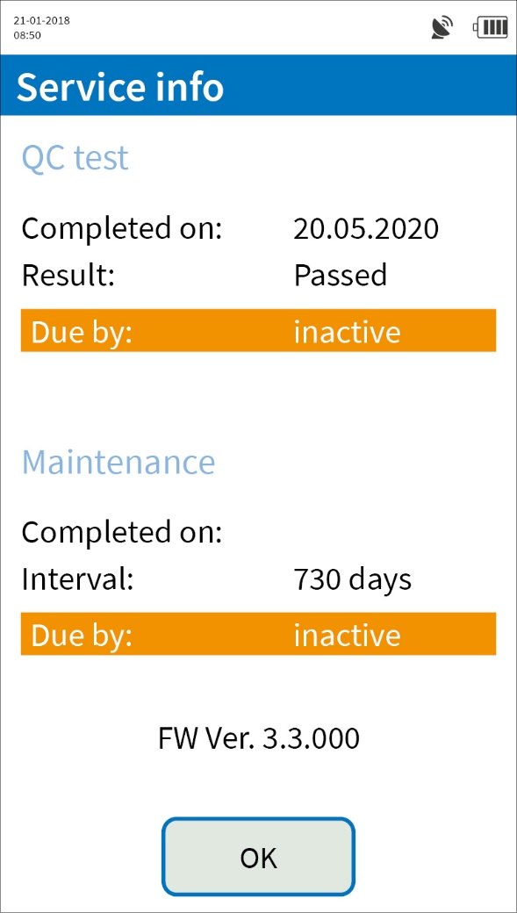
Service info
When using the device for the first time, the intervals are inactive and need to be activated once.
The user is prompted to do this automatically after the device has been switched on for the first time.

Slide 23
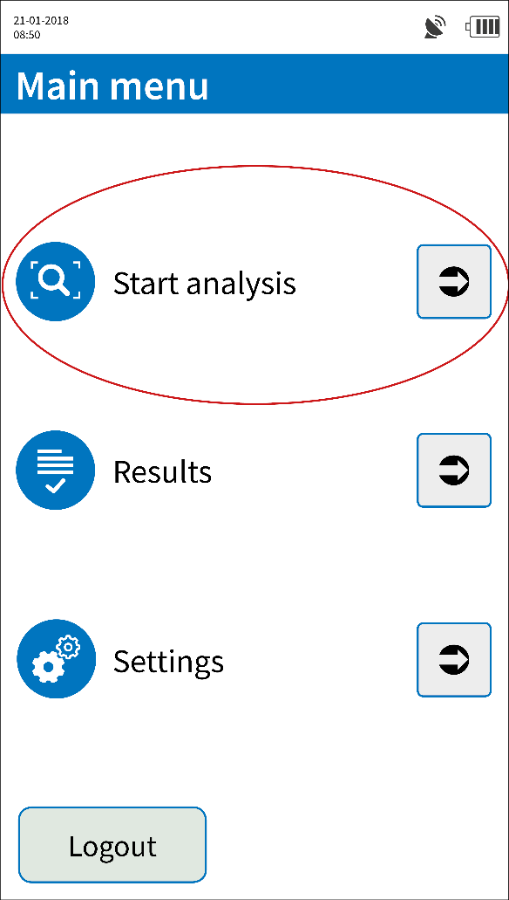
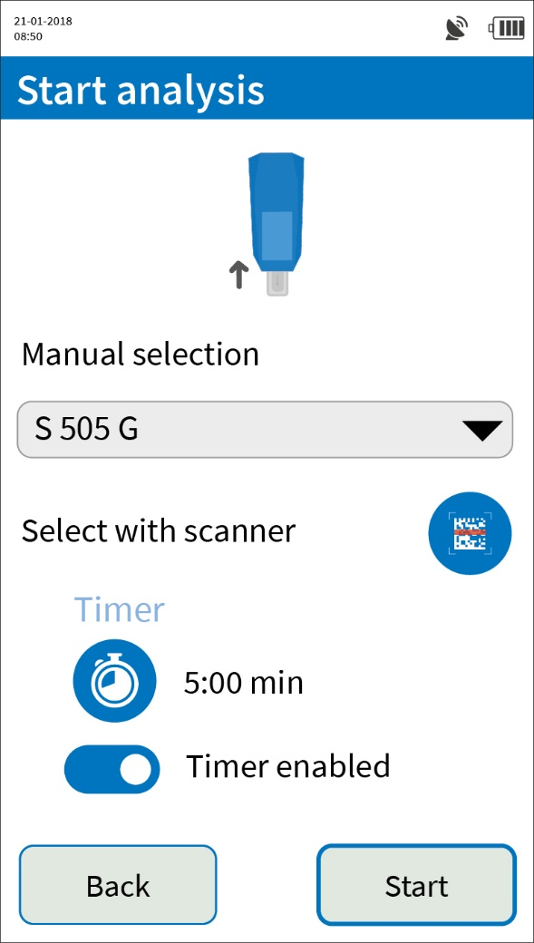
How to prepare for a measurement
The DrugWipe type can be selected manually or by scanning the barcode on the tubular bag.

Slide 24
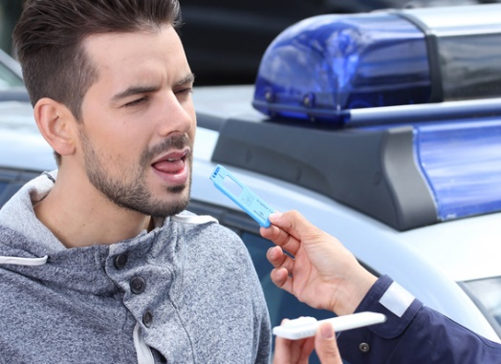


2 readout methods after sample collection
Sample collection according to DrugWipe instructions for use
The test is initiated in WipeAlyser and automatically read after a preset time.
The test is initiated outside WipeAlyser, the time is taken manually and then read in WipeAlyser.
Timer enabled
Timer disabled

Slide 25
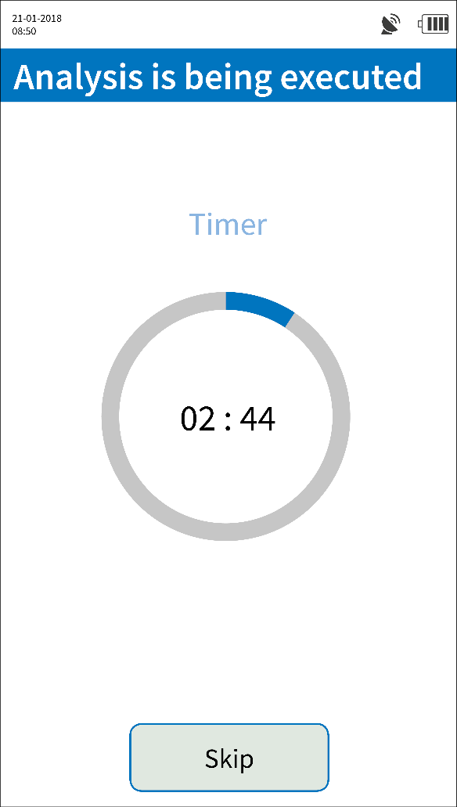
How to perform the analysis
While the test develops, place the device on a level surface or hold it horizontally and do not tilt.
Prolonged or excessive tilting (>30°) will abort the measurement.
If the device detects a tilt, the user is alerted by
the water level symbol (and possibly an acoustic signal):
Do not move or withdraw the DrugWipe during the measurement.
Make sure that the DrugWipe is inserted all the way (otherwise, level sensor will prevent measurement).

Slide 26
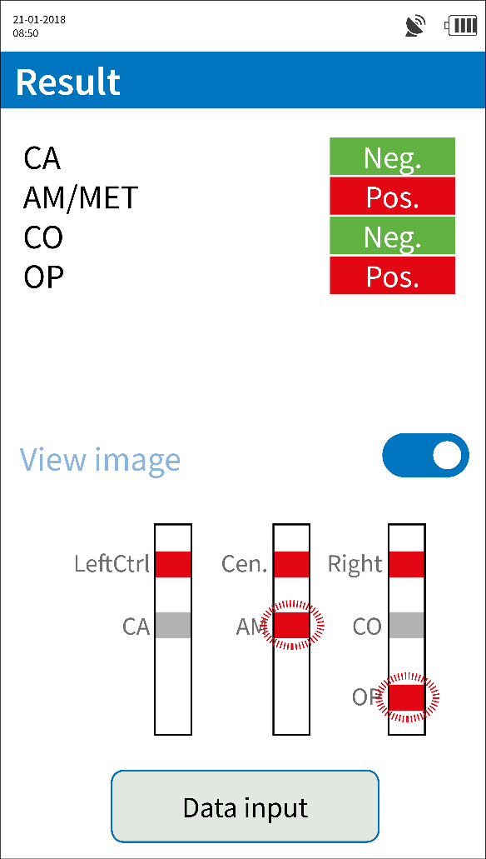
Result display
The test result on the left is positive for amphetamines/methamphetamine and opiates and negative for cannabis and cocaine.
The View image button lets you enable a schematic view of the lines on the DrugWipe.
Red (positive)
test lines will flash

Slide 27
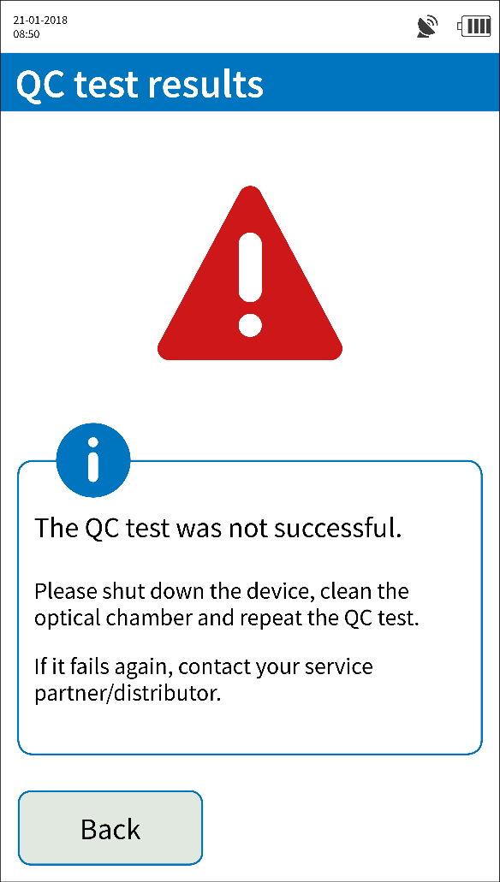
Result display
If the result is invalid, the measurement must be repeated.
One reason for invalid results could be excessive tilting of the device during the measurement.

Slide 28
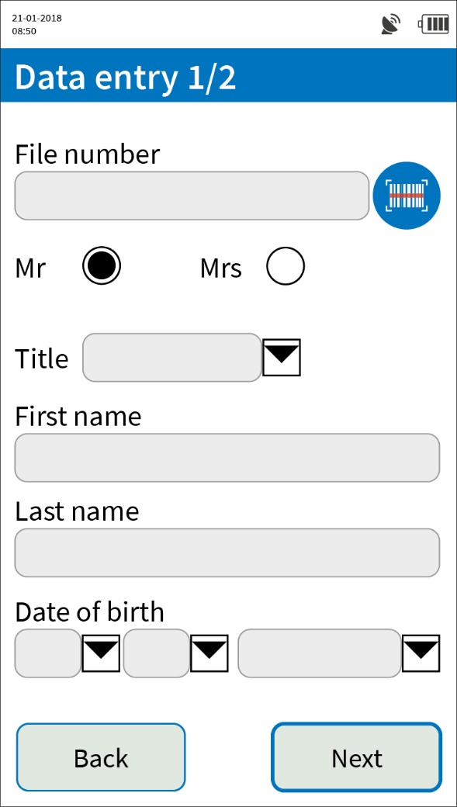
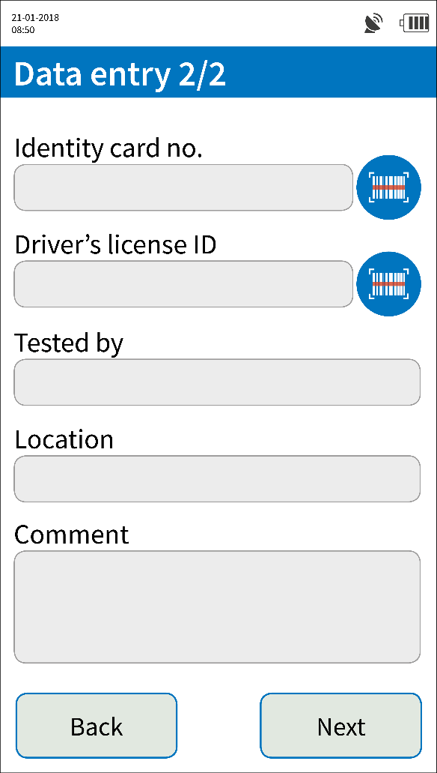

Data Input
The administrator configures the fields as mandatory or optional.
You use the scanner icon to activate the integrated scanner and enter a barcode.

Slide 29
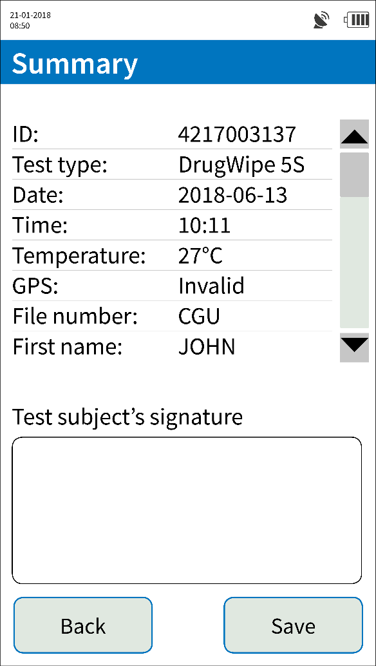
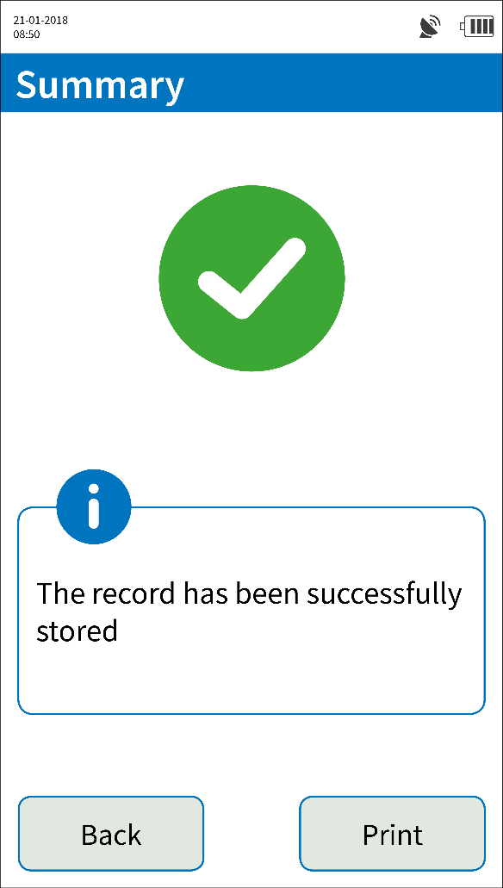
Data Input – Summary
A summary appears after data input.
The test subject can sign using the finger or stylus.
After storing the record, it can be output using the built-in printer.
The electronic signature is only stored in the device.

Slide 30
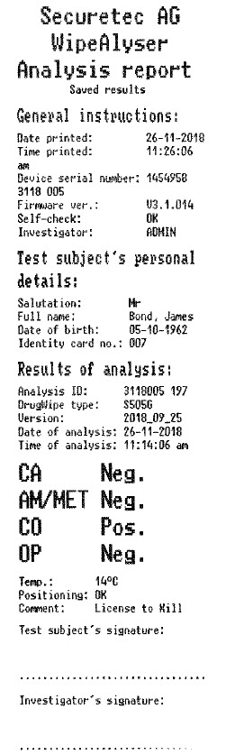
Printing
The printout contains all the data fields that were filled out (except for the test subject’s signature).
It also shows all the device and test data.

Slide 31

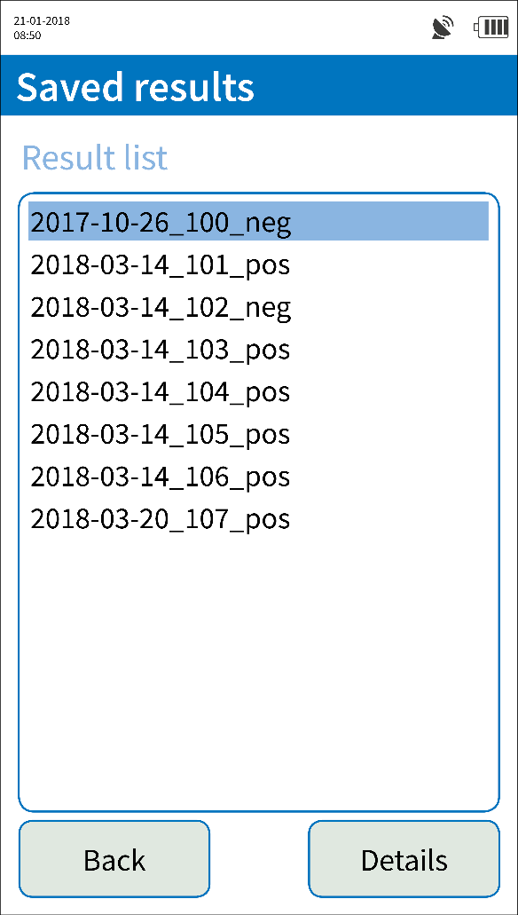
How to view stored results
Select Results from the main menu to view stored records.

Slide 32
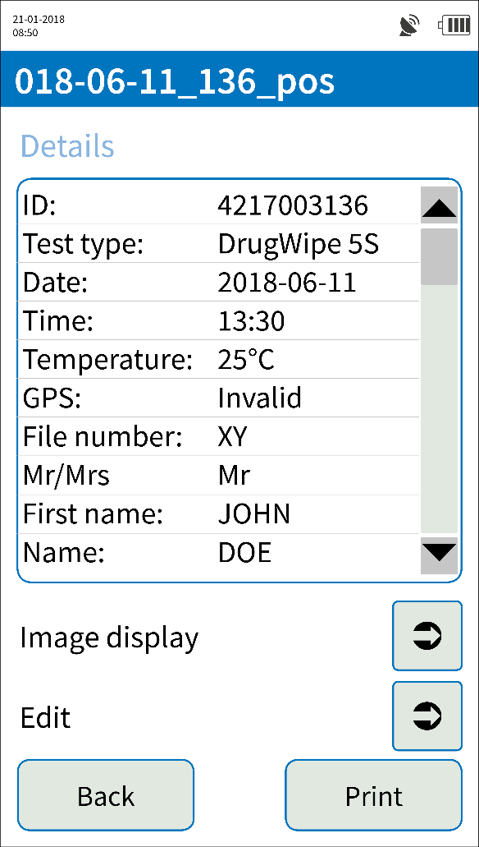
Result display
Details lets you view all the stored data.
Display image lets you view a screenshot of the DrugWipe read out window and the electronic signature.
Edit lets you retroactively modify the entries in the record.
(Note: The Edit function may require administrator rights.)
The result itself is not editable.

Slide 33

Maintenance & service
WipeAlyser must be serviced and possibly calibrated every two years.
If the device is due for service, a warning appears during start-up.
Servicing and calibration tasks are performed by the manufacturer.
Please contact your service partner.

Slide 34
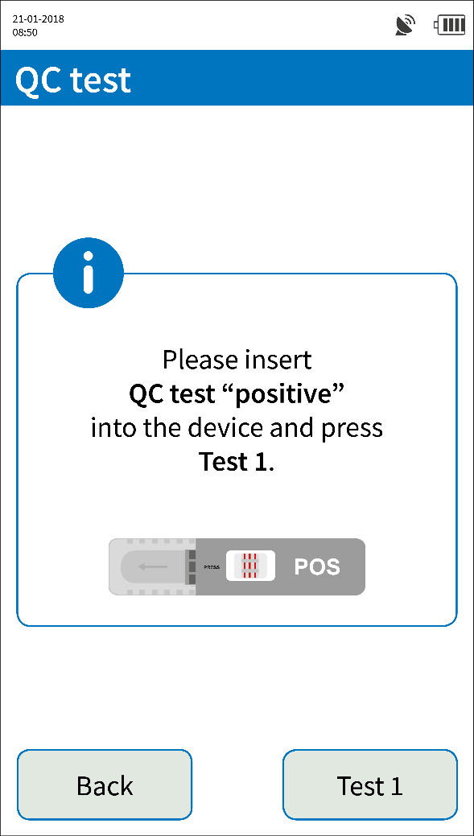
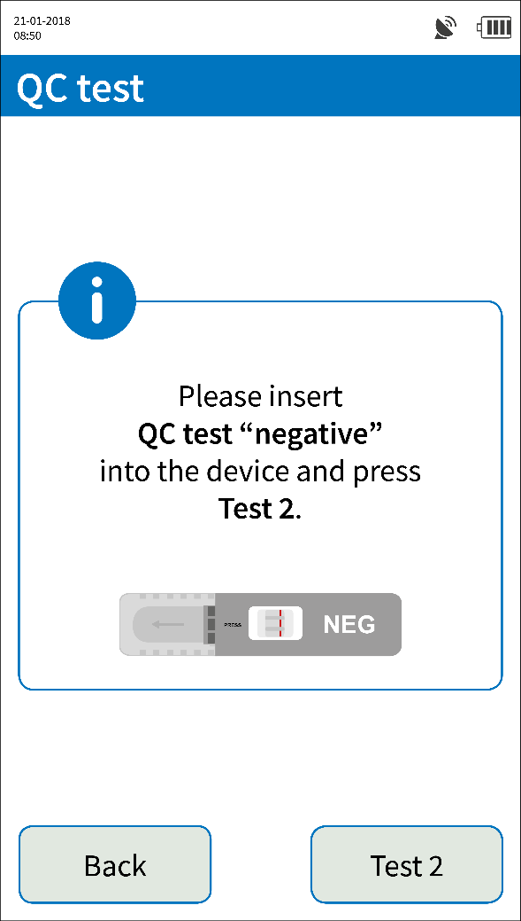
QC test
The QC test interval is configured by the administrator.
Insert the QC test cartridges one by one and confirm by selecting Test 1 or Test 2.
In case of abnormalities or implausible measurement results, we recommend running an unscheduled QC test.

Slide 35
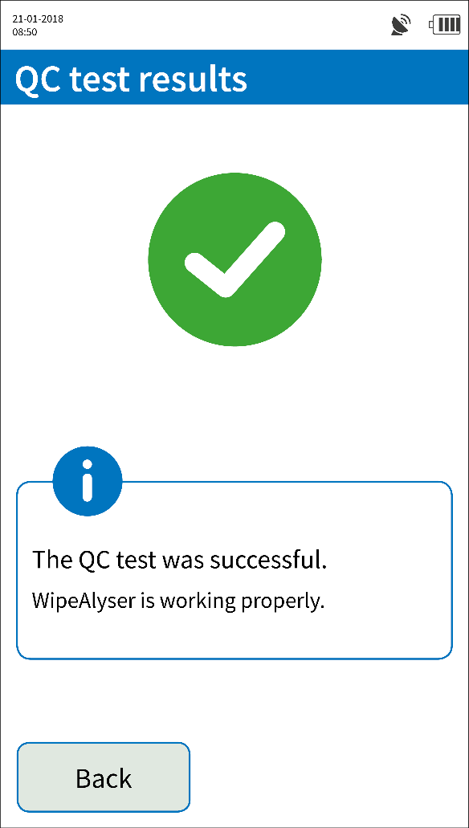
QC test
If the QC test is a pass, the test interval is automatically reset.
In case of an error message, the QC test must be repeated.
If the test is another fail, please contact your service partner.

Slide 36
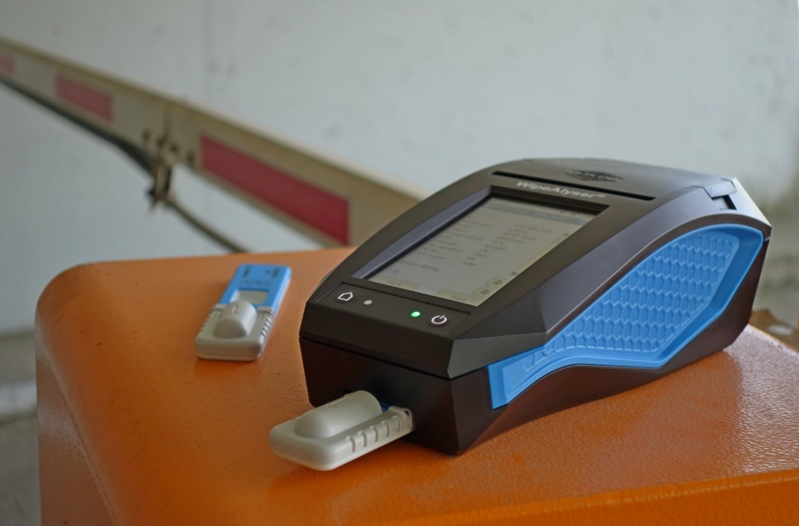
WipeAlyser Training
Part 3: Settings

Slide 37
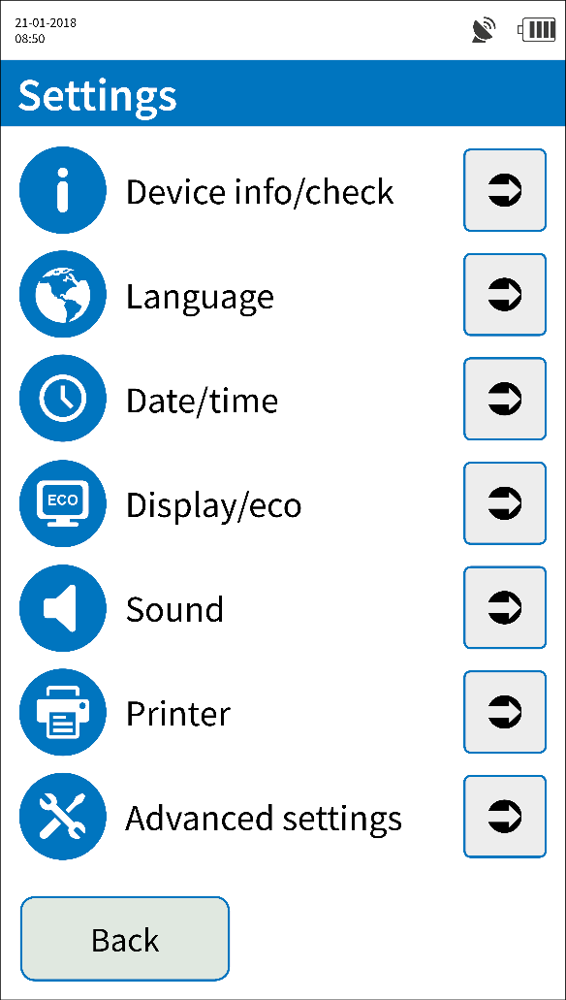
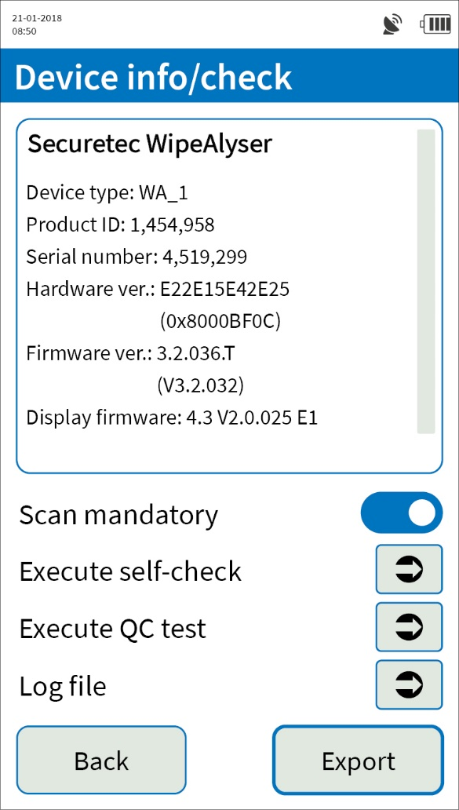
Device info/check
Device info/check lets you view device information.
If Scan mandatory is activated, the barcode on the DrugWipe tubular bag must be scanned before each test in order to verify the test type, batch and
shelf life.
Special rights required

Slide 38
Device info/check
In this menu it is possible to manually initiate a self-check or QC test.
Export lets you print or save the device information to an SD card, for example in case of a complaint.

Slide 39
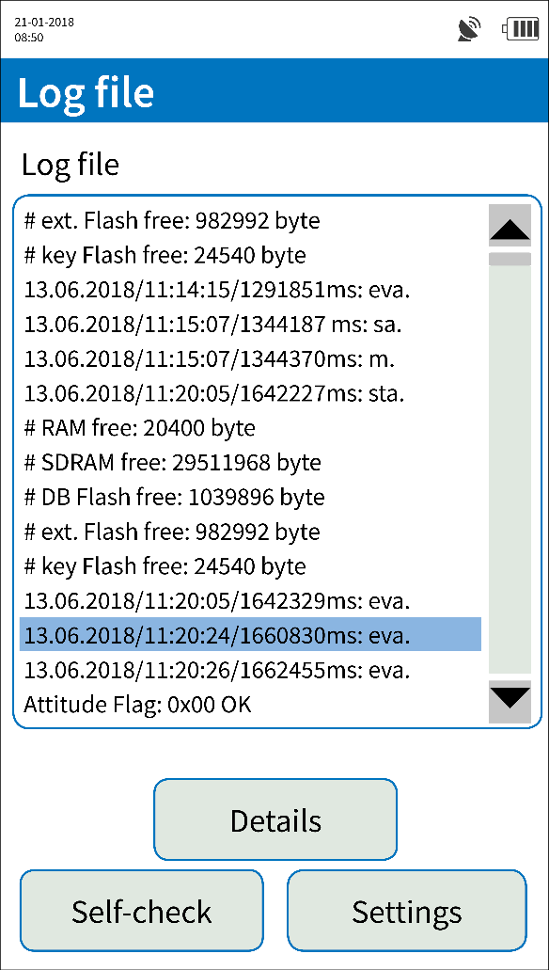
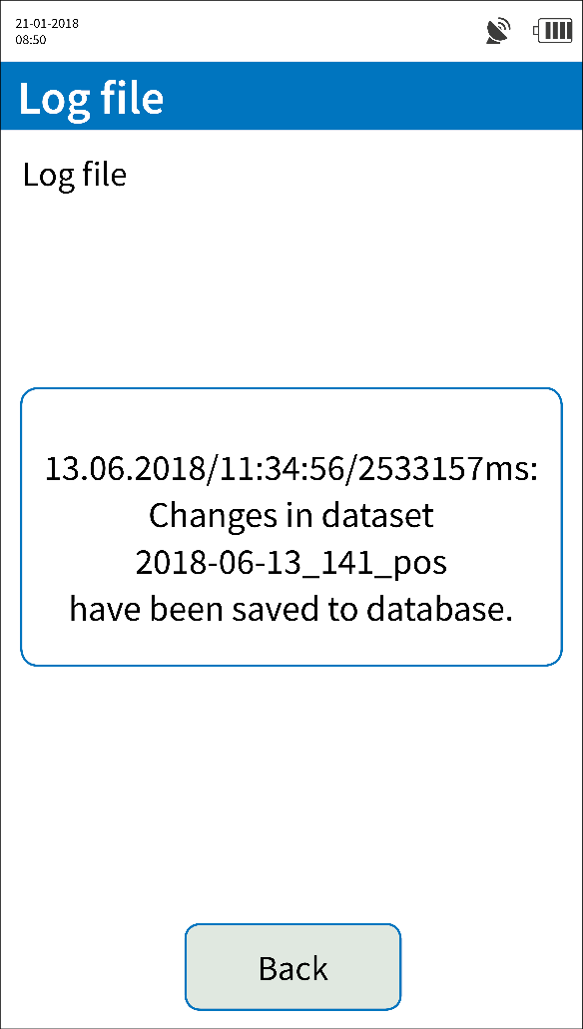
Log file
The log file is a record of all the actions performed on the device.
Select individual entries to view their details.

Slide 40
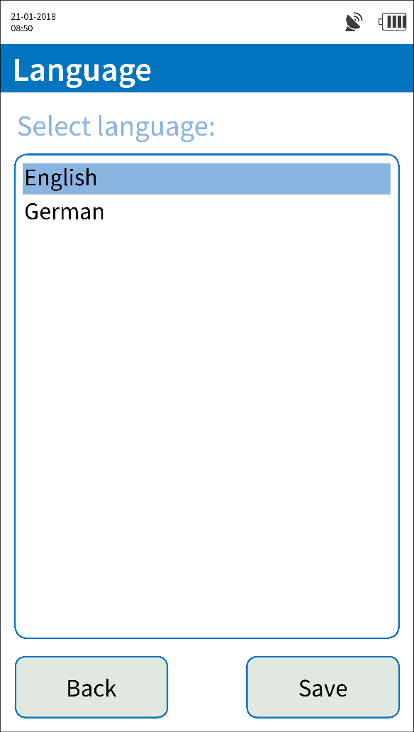
Language
Language lets you configure language settings.

Slide 41
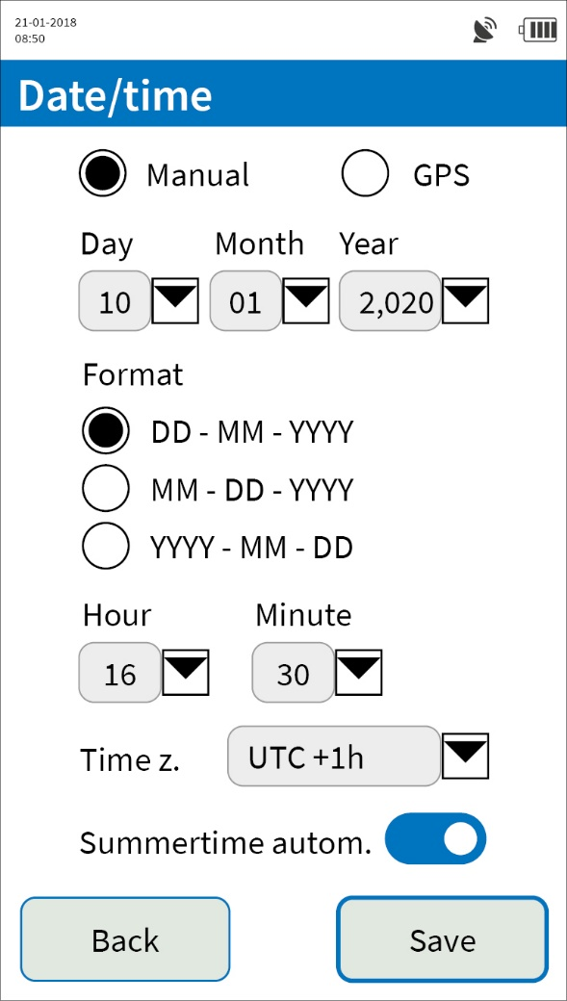
Date/time
Date and time can be set manually or automatically via GPS.
Without GPS reception, the date and time can only be entered manually.
Format lets you configure the date format.

Slide 42
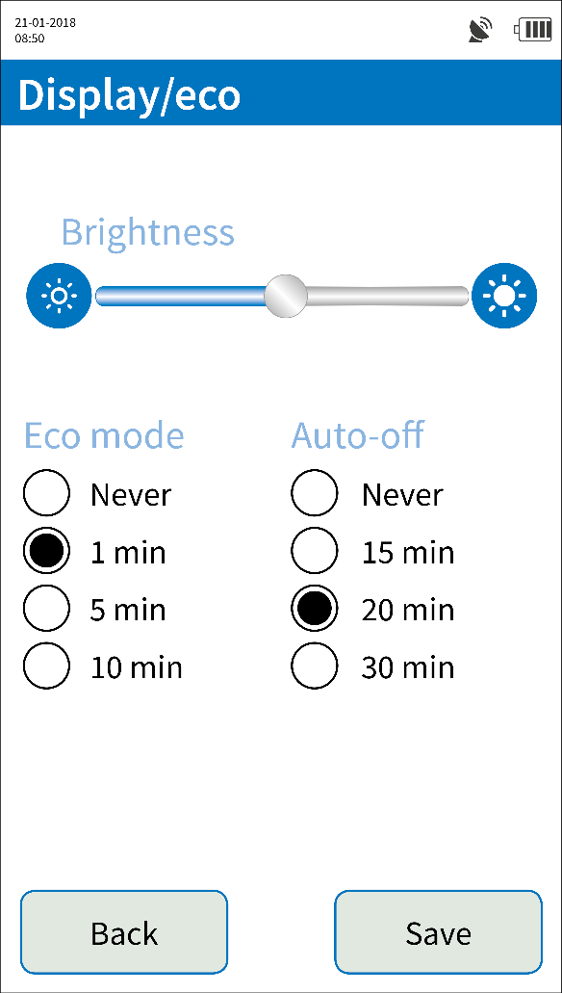
Display/eco
Decreasing the display brightness will save power.
In Eco mode, the display will be dimmed while the device remains powered on (blue LED).
WipeAlyser will automatically power off after the time defined under Auto-off has elapsed.

Slide 43
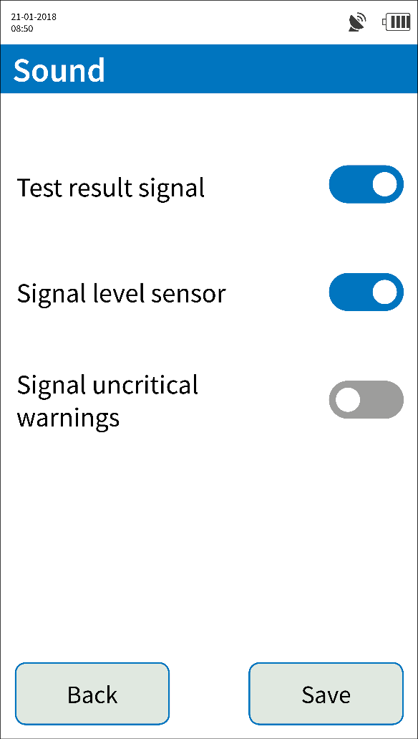
Sound
Test result signal will indicate completion of the measurement by an acoustic signal.
Signal level sensor will warn the user in case of excessive tilting of the device.
Uncritical warnings can be indicated by an acoustic signal if desired.

Slide 44
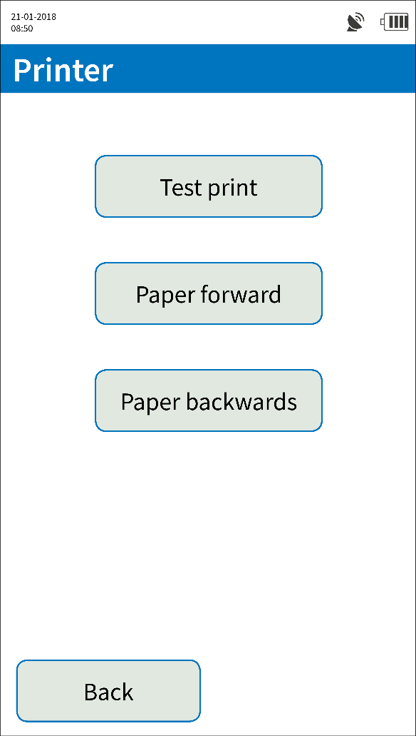
Printer
The Printer menu lets you generate a test print.
The Paper forward and Paper backwards buttons lets you advance or retract the printer paper.
Paper feed is automatic when installing a new roll.

Slide 45
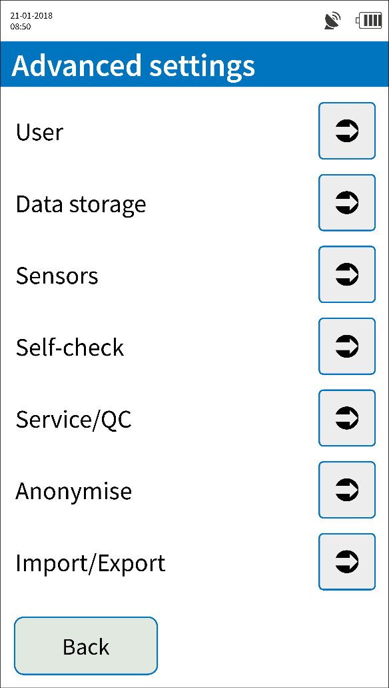
Advanced settings
Special rights required
By default, advanced settings are restricted to administrators and super users.
Administrators can grant other users individual rights and create
new users.

Slide 46

User management
Special rights required
Login – With user data only lets you disable the default user.
In this case, access to the device requires the unique user ID.

Slide 47

User management
Special rights required
User summary lets you view the currently stored users.
The administrator can define two user levels: User and Super user.

Slide 48

User management
Special rights required
New user lets you create
a new user profile.
The password to be assigned must be entered twice and can be displayed if necessary.
Rights management lets you define the user group.

Slide 49

User management
Special rights required
Deletion of a user cannot be undone.
The data entered for the deleted user are retained.

Slide 50

User management
Special rights required
Rights management lets you define the changes that can be made to users and super users.
Generally, administrator rights are never restricted.

Slide 51

Record
Special rights required
Record lets you define the data entries that are mandatory or optional.
Disabled fields are greyed out during input.
Either Name or Drivers license ID or Identity card no. must be a mandatory field.

Slide 52

Sensors
Special rights required
The GPS sensor can be deactivated completely.
The current temperature and details about the correct level can be stored with every record.
If the temperature is outside the permitted range, the system can issue a warning or the test can be disallowed.

Slide 53
Sensors
Special rights required
The timer can be switched on or off as standard. It is also possible to make this setting switchable so that, for each test, the user can decide whether the result is to be read immediately or not until the test runtime has elapsed.

Slide 54

Self-check
Special rights required
We recommend running the self-check each time the device is powered on.
Errors that are detected during the self-check can be defined as critical and disallow measurement.
Device errors that prevent measurement are always critical.

Slide 55

Service/QC tests
Special rights required
Notifications that service or QC test is due can be disabled.
QC test – Interval lets you define the intervals for required QC tests.
The service interval is configured by Securetec when the product ships (typically 2 years).

Slide 56
Service/QC tests
Special rights required
If QC test mandatory is activated, analysis cannot be performed after a failed QC test until another QC test has been successfully completed.

Slide 57

Anonymise
Special rights required
Anonymise will irreversibly delete all personal data from the device’s internal memory.
The (anonymised) measurement data are retained.
Always anonymise stored data before the device is transferred to third parties (privacy).

Slide 58

Import/Export
Special rights required
The stored data can be exported to an SD card from which it can later be re-imported. This is useful for backing up the device.
Exported data are encrypted and only readable by a WipeAlyser (but not necessarily the same device).

Slide 59




Data structure on the SD card
Any exports are stored on the SD card under:
Device serial no.
100. measurement on 12/05/2020
…
…
…
Log file
Can be read
with text editor
Device info file
Fullimage1_0.bmp
Data export
(proprietary database format,
can be read via WipeAlyser –> Import)
…
…
…

Slide 60
WipeAlyser Training
Part 4: DATA MANAGER software

Slide 61

How to install the software
The installation file is provided on the USB stick included with the delivery.
The software runs on Windows (version 7 or later).
Prior to and during installation, a WipeAlyser must be connected to the PC and powered on to load the required drivers.
Desktop icon

Slide 62

Login
Log in as User or Administrator.
Administrators are also able to delete data from the device.
In both cases, the preset password is “securetec”.

Slide 63

Change password
System – Change password should be used to change the password after the first login.

Slide 64

Change password
System – Change password should be used to change the password after the first login

Slide 65

Info
System – Info shows information about the system.

Slide 66

How to set the language
Language lets you set the language.

Slide 67

How to connect WipeAlyser
Click Connect to connect the WipeAlyser to the software.
After successful connection, the device appears in the window.
WipeAlyser detected

Slide 68

Loading results
Clicking Load results generates a list with the records stored on WipeAlyser.

Slide 69

How to select data
To select individual rows, press and hold down the CTRL key and click on the relevant rows.
If you press and hold down the SHIFT key and click on individual columns, you can deactivate these columns so that they are ignored when you save.

Slide 70
How to transfer data
Export all or Export selection lets you transfer all or selected records to the PC.
The data are exported to the selected location as an Excel file.

Slide 71

How to select data
Special rights required
Administrators can use Delete all to delete all data from the device.

Slide 72

How to select data
Special rights required
Delete selection lets you delete selected records from the device.

Slide 73

WipeAlyser Training
Part 5:
Information for partner distributors

Slide 74


Device shipments
Make sure the packaging is shock-proof.
Two copies of the UN3481 label and the shipper’s phone number must be added to the outside of the package.
MSDS for the batteries must be placed inside the package on top of the contents.
The type designation of the battery must be noted on the commercial invoice.
Observe country-specific requirements.
Contact Securetec in case of questions.

Slide 75
Service/calibration
Partner:
Visual inspection
Cleaning
Perform QC tests
Inspection not passed: Contact Securetec
No concerns:
Return to customer
Remote maintenance session via Teamviewer as needed
Problem solved
Problem persists:
Send to Securetec

Slide 76
Firmware updates
The firmware consists of several components:
The firmware itself (at the present time, needs to be updated by Securetec via Teamviewer)
Language Table (file on SD card): contains language packs
XML files (file on SD card): contains DrugWipe info and test parameters
Service file (on SD card)
Reference images of the various blank strips (on SD card)
Contact: Peter Hoffmann
service@securetec.net

Slide 77


What to do after detecting a bug
Notify Securetec
Take a screenshot when the bug occurs
Document the steps leading up to the bug
Firmware version of the device in question
Serial number of the device
Log file (if applicable)
Additional info that may be relevant

Slide 78
Thank you for your time.

Slide 79

Contact
Max Mustermann
position
Securetec Detektions-Systeme AG
Lilienthalstraße 7
85579 Neubiberg
Germany
P +49 89 203080-1651
F +49 89 203080-1652
info@securetec.net
www.securetec.net
© Securetec Detektions-Systeme AG

